Slide 1

Applied Distributed Systems
The Cloud 1

Slide 2
Overview
Structure
Scaling Service Capacity
Time

Slide 3
Data centers in the cloud
A cloud provider (AWS, Google, Microsoft) maintains data centers around the world.
Each data center has ~100,000 computers.
Limited by power and cooling considerations.

Slide 4
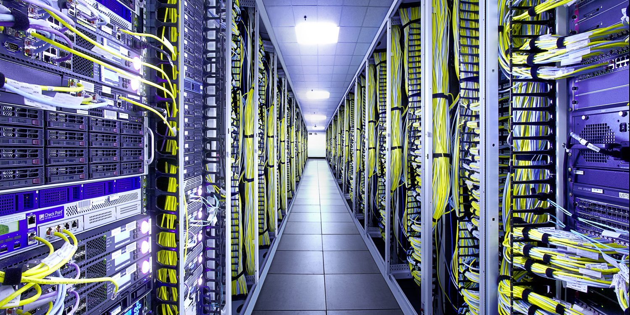
Data Center

Slide 5
Organization of data centers
Each data center has independent power supply, independent fire control, independent security, etc
Data centers are collected into availability zones and availability zones are collected into geographic regions.
AWS now has 24 geographic regions and has announced plans for five more regions in Indonesia, Japan, Spain, India, and Switzerland.

Slide 6
Allocating a virtual machine in AWS - 1
A user wishes to allocate a virtual machine in AWS
The user specifies
A region
Availability zone
Image to load into virtual machine
…

Slide 7
Allocating a virtual machine in AWS - 2
AWS management software
Finds a server in that region and availability zone with spare capacity
Allocates a virtual machine in that server
Assigns IP address to that virtual machine (public)
Loads image into that virtual machine
VM can then send and receive messages

Slide 8
AWS access stastics
Amazon reports: we [AWS] authenticate and authorize over 400 million API calls EVERY SECOND.
Think about what their architecture must be to support this kind of load.

Slide 9
Overview
Structure
Scaling Service Capacity
Time

Slide 10
Load Balancer - 1
One server may not suffice for all of the requests for a given service.
Have multiple servers supplying the same service.
Use “load balancer” to distribute requests.
Server is registered with load balancer upon initialization

Slide 11
Load Balancer - 2
Load balancer monitors health of servers and knows which ones are healthy.
All servers managed by one load balancer are identical
Load balancer IP is returned from DNS server when client requests URL of service.

Slide 12
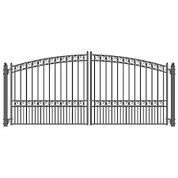
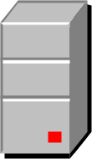

Message sequence – client 1 makes a request
Clients
Gateway
Load Balancer
Servers

Slide 13
Message sequence – request goes through gateway
Clients
Gateway
Load Balancer
Servers

Slide 14
Message sequence – request goes to load balancer
Clients
Gateway
Load Balancer
Servers

Slide 15
Message sequence – request is forwarded to one server
Clients
Gateway
Load Balancer
Servers

Slide 16
Message sequence – client 2 makes a request
Clients
Gateway
Load Balancer
Servers

Slide 17
Message sequence – request goes through same path but is forwarded to a different server
Clients
Gateway
Load Balancer
Servers

Slide 18
Note IP manipulation
Load balancer changes destination IP of message and forwards it to server.
Options for source IP of message sent to server.
May be unchanged. In this case response goes directly back to client or gateway
May be IP of load balancer. In this case, load balancer is acting as a proxy
Server will always return to source IP in message it receives

Slide 19
Routing algorithms
Load balancers use variety of algorithms to choose instance for message
Round robin. Rotate requests evenly
Weighted round robin. Rotate requests according to some weighting.
Hashing – IP address of source to determine instance. Means that a request from a particular client always sent to same instance as long as it is still in service.
Note that these algorithms do not require knowledge of an instance’s load.

Slide 20
Suppose servers become overloaded
As load grows, existing resources may not be sufficient.
Autoscaling is a mechanism for creating new instances of a server.
Set up a collection of rules that determine
Under what conditions are new servers added
Under what conditions are servers deleted

Slide 21
First there were three servers
Load Balancer
Servers

Slide 22
Now there are four
Issues:
What makes the decision to add a new server?
How does the new server get loaded with software?
How does the load balancer know about the new server?

Slide 23
Making the decisio
autoscaler
Each server reports its CPU and I/O usage to an autoscaler
Autoscaler has a collection of rules to determine whether to add new server. E.g. one server is over 80% utilization for 15 minutes

Slide 24
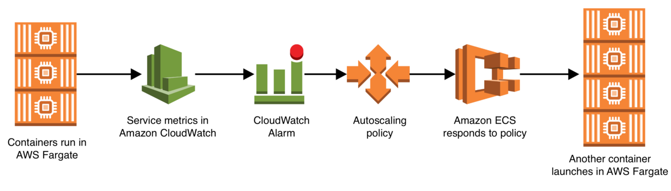
AWS Autoscaler

Slide 25

Loading the new server with software
When a new instance is created, it is created based on a launch configuration, security groups, etc
Configuration specifications

Slide 26
Making the load balancer new server aware
The new server is registered with a load balancer by the autoscaler.

Slide 27
Overview
Structure
Scaling Service Capacity
Time

Slide 28
Time In a distributed system
Many protocols involve putting a time stamp on messages or logs
Problem is that clocks drift and so clock time may be different on different computers.

Slide 29
Clock drift
Clocks on a modern processor may drift 1 second every million seconds (11+ days)
This means two computers will have different time readings.
Relative times within a single computer will be accurate
But using time to sequence events across a network will not be accurate.

Slide 30
Synchronizing clocks across a network
Suppose two different computers are connected via a network. How do they synchronize their clocks?
If one computer sends its time reading to another, it takes time for the message to arrive.
NTP (Network Time Protocol) can be used to synchronize time on a collection of computers. Involves having a server that sends out network time periodically.
Accurate to around 1 millisecond in local area networks
Accurate to around 10 milliseconds over public internet
Congestion can cause errors of 100 milliseconds or more.

Slide 31
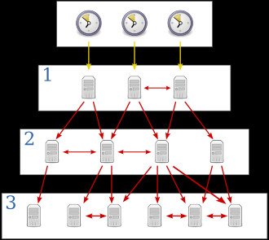
NTP

Slide 32
Suppose NTP is insufficiently accurate
Financial industry spent100s of millions of dollars to reduce latency between Chicago and New York by 3 milliseconds.
Well within error range of NTP
GPS time is accurate within
14 nanoseconds (theoretically)
100 nanoseconds (mostly)
Timestamp messages with GPS time
Used by electric companies to measure phase angle
Atomic clocks
Used by Google to coordinate time across all of their distributed systems.

Slide 33
Tracking operations across the cloud
Suppose a request involves multiple computers in the cloud
Tracking this request with time involves expensive mechanisms (GPS, Atomic clock).
Other mechanisms must be used to track requests (discussed later).

Slide 34
Summary
The cloud is composed of a collection of independent data centers scattered around the globe
Load balancers are used to distributed requests among identical servers
Autoscaling is a mechanism to increase the number of servers if they get overloaded.
Time within a server is accurate, across servers it is inaccurate.

